Slide 1

Lecture 3: HTML Basics
Open Source Web Software

Slide 2
In the last lecture
Course overview
Objectives, schedules, evaluation and policies
WWW: World Wide Web
History of WWW
Client and Server
Frontend vs. Backend

Slide 3
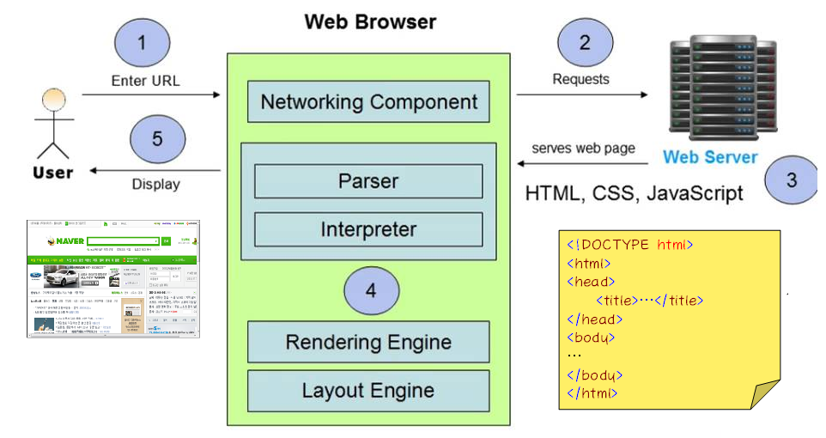
In the last lecture
Step-by-step illustration of how WWW works
Frontend
Backend

Slide 4
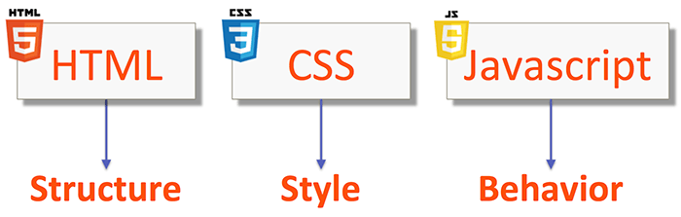
In the last lecture
Web page content is written in HTML5
Web page style specified as CSS3
Web page interaction/behavior is written in JavaScript

Slide 5
Table of Contents
Part 1.
HTML Overview
Part 2.
HTML Elements

Slide 6
HTML Overview
PART 1

Slide 7

What is HTML?
HTML stands for Hyper Text Markup Language
HTML is a markup language for creating Web pages

Slide 8
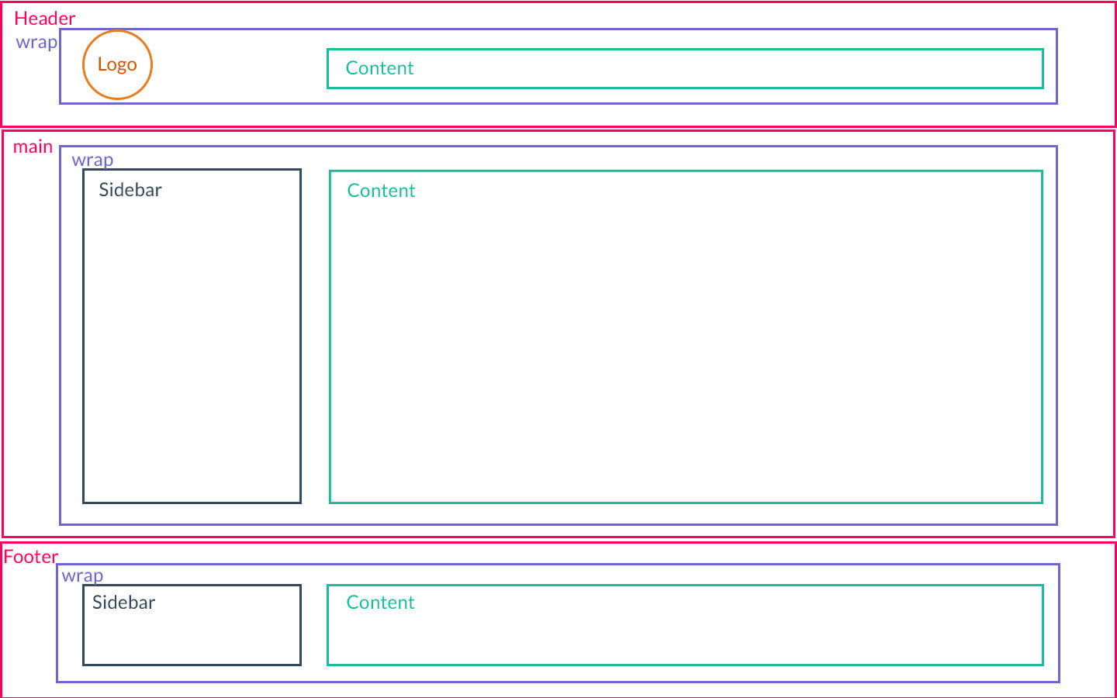
What is HTML?
HTML describes the structure of a Web page

Slide 9
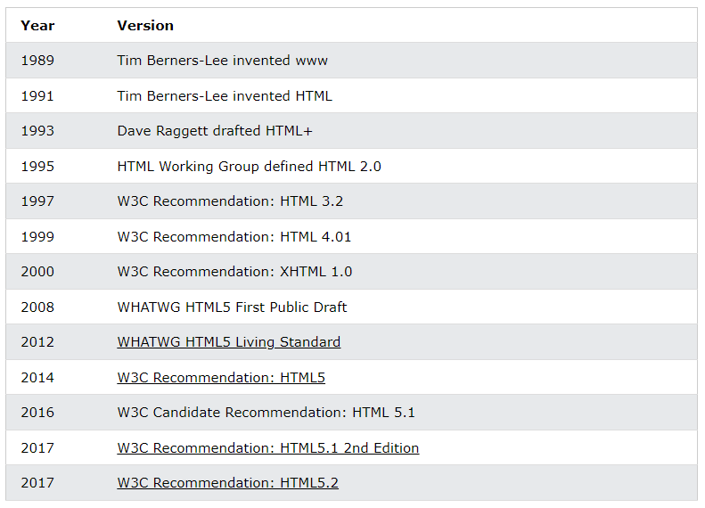
History of HTML
HTML5 is the latest version of HTML

Slide 10
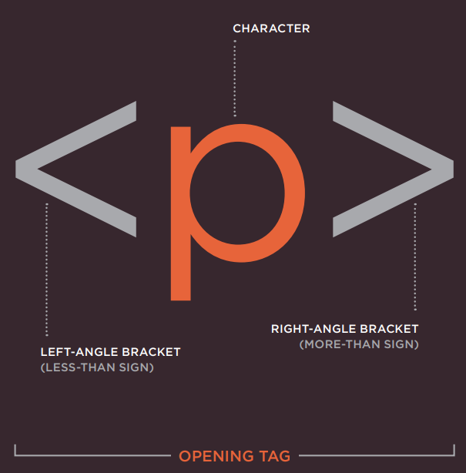
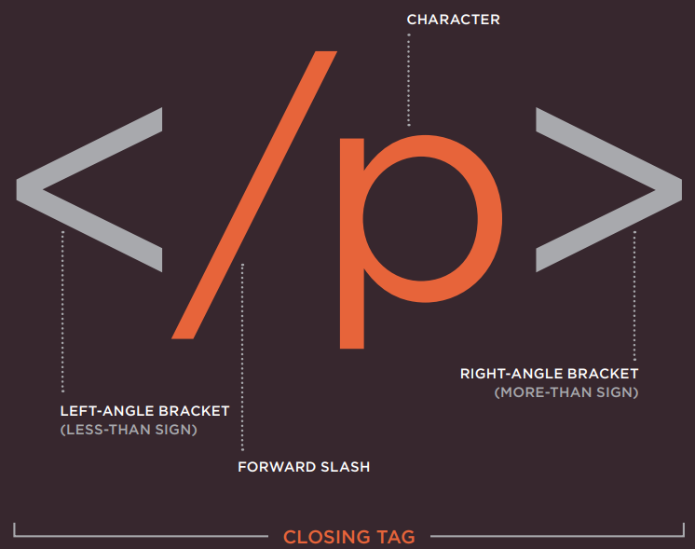
HTML Tags
HTML consists of a series of elements that are represented by tags
HTML tags are element names surrounded by angle brackets
Note that some of the tags do not need a closing tag
Singleton tags or empty tags

Slide 11
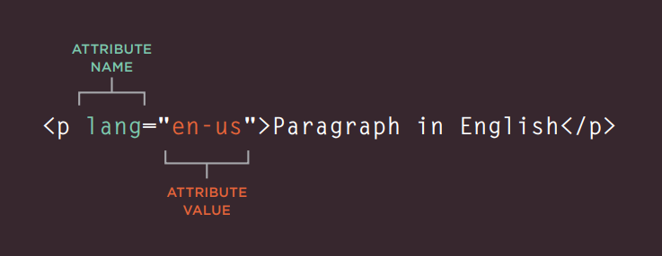
HTML Attributes
HTML attributes provide additional information about the elements
Appear on the opening tag of the element
Has two parts: name and value

Slide 12
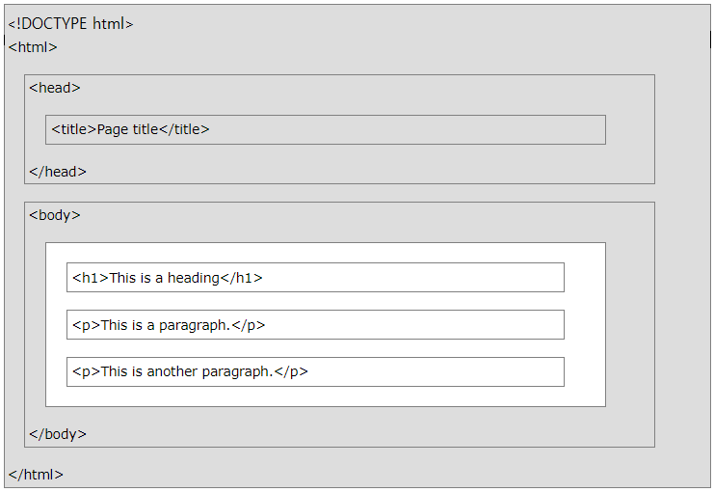
HTML Page
Basic HTML page structure
Elements in grey box MUST have in every HTML page

Slide 13
HTML Page
<!DOCTYPE html>
Helps browsers to display web pages correctly
Must only appear once, at the top of the page (before any HTML tags)
<html>…</html>
Surrounds the contents of the entire page
<head>…</head>
Contains information about web page
<title>…</title>
Gives the name of the web page that appears in the top of the browser window
<body>…</body>
Contains the content of the page to be displayed in the browser

Slide 14
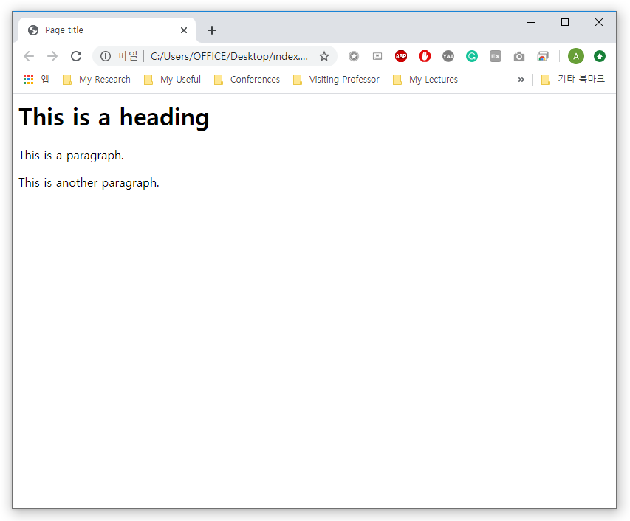
Web Browser
Web browser interprets HMTL elements and displays the content
The web browser does not display the HTML tags or its attributes
Anything written between the <title> tags will appear in the title bar of the web browser
Anything written between the <body> tags will appear in the main browser window

Slide 15
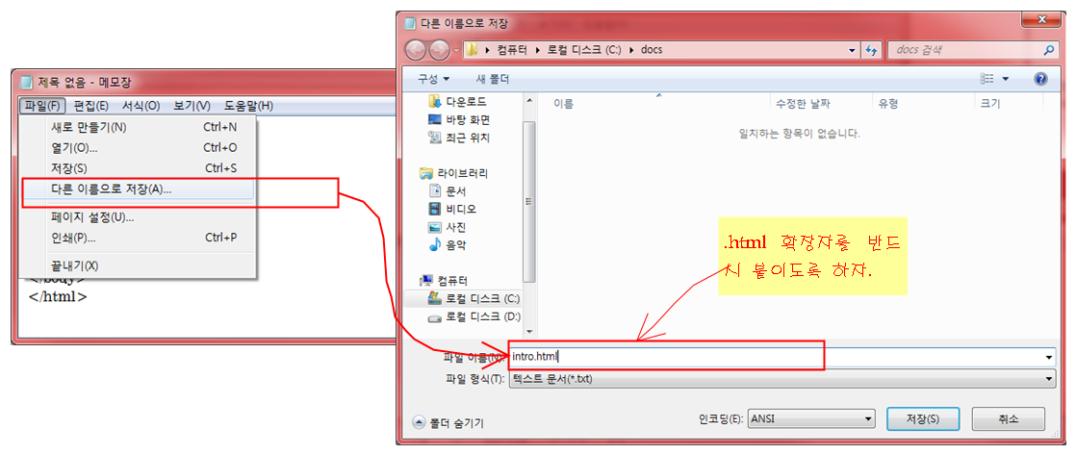
HTML Extension
HTML files have .html extension
Always put .html at the end of the file

Slide 16
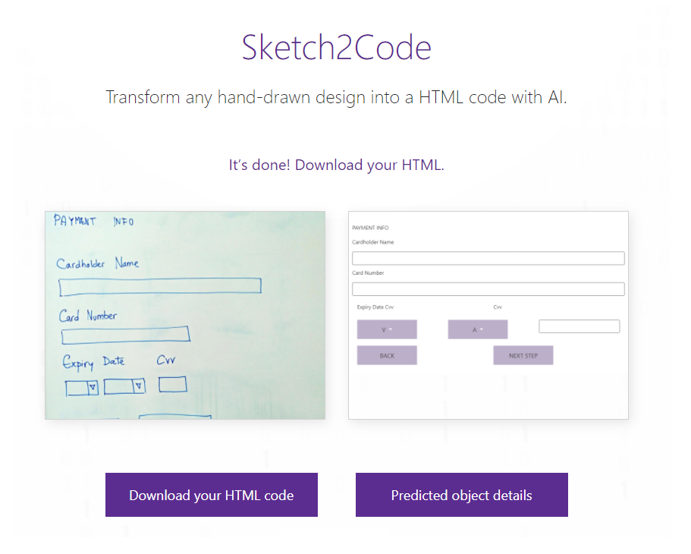
Recent Advances of HTML
Sketch2Code by Microsoft AI

Slide 17
Summary
HTML stands for Hyper Text Markup Language
HTML describes the structure of a Web page
HTML5 is the latest version of HTML
HTML consists of a series of elements that are represented by tags
Web browser interprets HMTL elements and displays the content
Must have elements
doctype, html, head, title, body

Slide 18
HTML Elements
PART 2

Slide 19
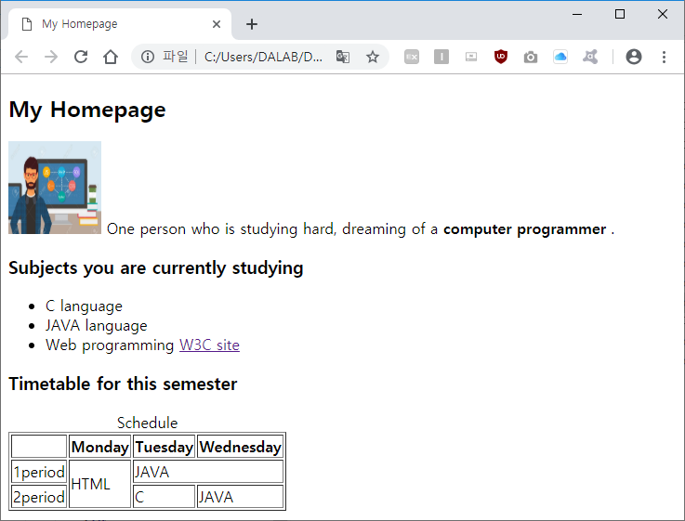
HTML Elements
The followings are the basic elements to build a simple webpage using HTML
We will make heading
We will insert picture
We will create list
We will insert text
We will create table
We will make hyperlink

Slide 20
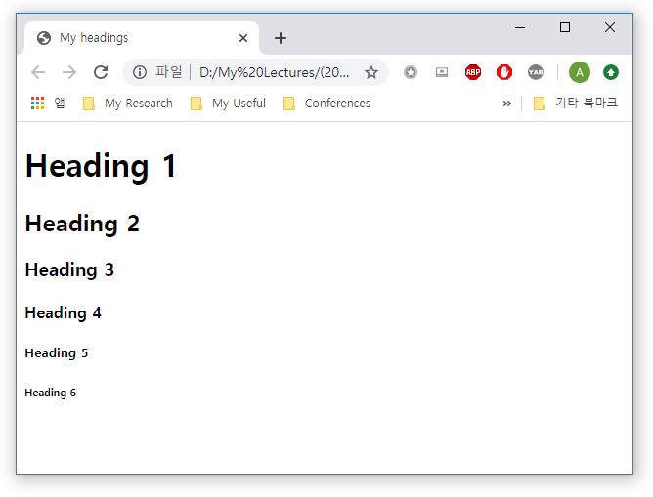
HTML Heading Elements
<h1> to <h6> tags
Use HTML headings for headings only
Don't use headings to make text BIG or bold
<!DOCTYPE html>
<html>
<head>
<title>My headings</title>
</head>
<body>
<h1>Heading 1</h1>
<h2>Heading 2</h2>
<h3>Heading 3</h3>
<h4>Heading 4</h4>
<h5>Heading 5</h5>
<h6>Heading 6</h6>
</body>
</html>

Slide 21
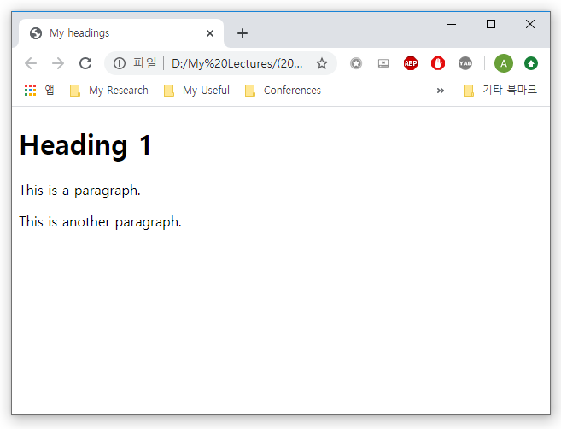
HTML Text Elements
<p> tag
Defines a paragraph
A blank line is added before and after the paragraph
<!DOCTYPE html>
<html>
<head>
<title>My paragraph</title>
</head>
<body>
<h1>Heading 1</h1>
<p>This is a paragraph.</p>
<p>This is another paragraph.</p>
</body>
</html>

Slide 22
HTML Text Elements
<p> tag
Don’t forget the end tag
It will work in most browsers, but do not rely on it
Dropping the end tag can produce unexpected results or errors
<!DOCTYPE html>
<html>
<head>
<title>My paragraph</title>
</head>
<body>
<h1>Heading 1</h1>
<p>This is a paragraph.
<p>This is another paragraph.
</body>
</html>

Slide 23
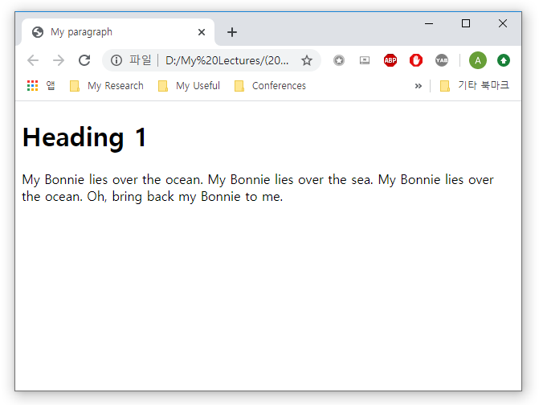
HTML Text Elements
<p> tag
Changing the line by pressing the Enter key in the HTML code does not change the line in the Web browser.
<!DOCTYPE html>
<html>
<head>
<title>My paragraph</title>
</head>
<body>
<h1>Heading 1</h1>
<p>
My Bonnie lies over the ocean.
My Bonnie lies over the sea.
My Bonnie lies over the ocean.
Oh, bring back my Bonnie to me.
</p>
</body>
</html>
Whole text displayed
in a single line

Slide 24
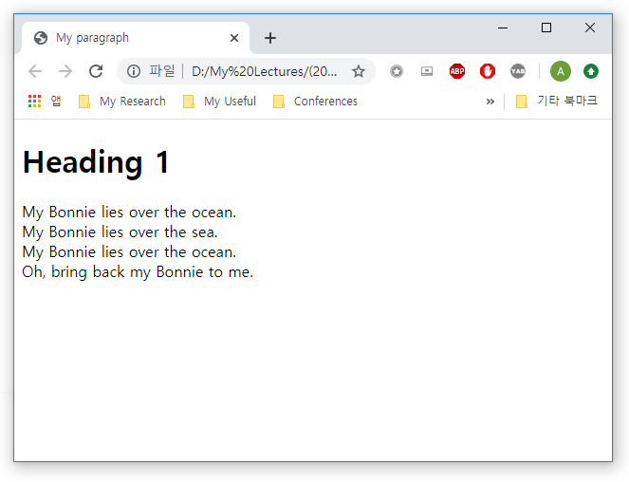
HTML Text Elements
<br> tag
Defines a line break
Use it if you want a line break without starting a new paragraph:
<!DOCTYPE html>
<html>
<head>
<title>My paragraph</title>
</head>
<body>
<h1>Heading 1</h1>
<p>
My Bonnie lies over the ocean. <br>
My Bonnie lies over the sea. <br>
My Bonnie lies over the ocean. <br>
Oh, bring back my Bonnie to me. <br>
</p>
</body>
</html>

Slide 25
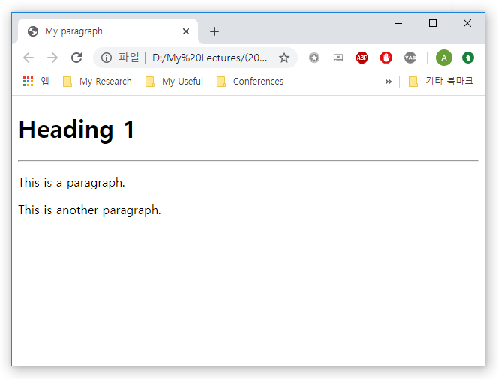
HTML Text Elements
<hr> tag
Defines a horizontal line
Used to separate content (or define a change) in an HTML page
<!DOCTYPE html>
<html>
<head>
<title>My paragraph</title>
</head>
<body>
<h1>Heading 1</h1>
<hr>
<p>This is a paragraph.</p>
<p>This is another paragraph.</p>
</body>
</html>

Slide 26
HTML Text Elements
Text formatting elements
Tag | Description
<b>…</b> | Make text bold
<i>…</i> | Make text italic
<strong>…</strong> | Make text strong
<em>…</em> | Emphasize text
<code>…</code> | Show text in code format
<sup>…</sup> | Superscript
<sub>…</sub> | Subscript

Slide 27
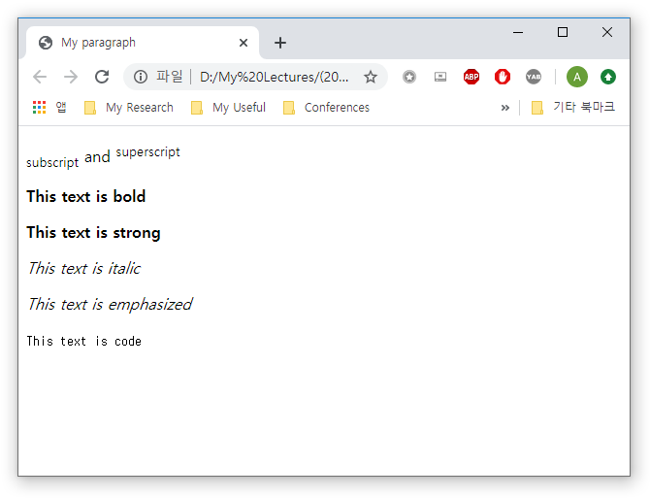
HTML Text Elements
Text formatting elements
Case-by-case example
<!DOCTYPE html>
<html>
<head>
<title>My paragraph</title>
</head>
<body>
<p><sub>subscript</sub> and <sup>superscript</sup></p>
<p><b>This text is bold</b></p>
<p><strong>This text is strong</strong></p>
<p><i>This text is italic</i></p>
<p><em>This text is emphasized</em></p>
<p><code>This text is code</code></p>
</body>
</html>

Slide 28
HTML Text Elements
HTML Quotations
Tag | Description
<abbr> | Defines an abbreviation or acronym
<address> | Defines contact information for the author/owner of a document
<bdo> | Defines the text direction
<blockquote> | Defines a section that is quoted from another source
<cite> | Defines the title of a work
<q> | Defines a short inline quotation

Slide 29
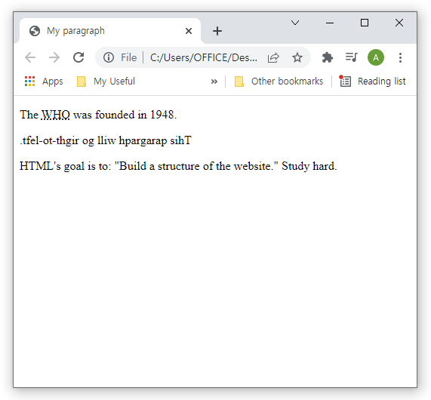
HTML Text Elements
HTML Quotations
Case-by-case example
<!DOCTYPE html>
<html>
<head>
<title>My paragraph</title>
</head>
<body>
<p>The <abbr title="World Health Organization">WHO</abbr>
was founded in 1948.</p>
<p><bdo dir="rtl">This paragraph will go
right-to-left.</bdo></p>
<p>HTML's goal is to: <q>Build a structure of the website.</q>
Study hard.</p>
</body>
</html>

Slide 30
HTML Text Elements
Special characters
Some characters may not be displayed because they overlap with HTML syntax
Special Characters | Explanation
&nbsp | Non breaking space
&lt; | <
&gt; | >
&quot; | “
&amp; | &

Slide 31
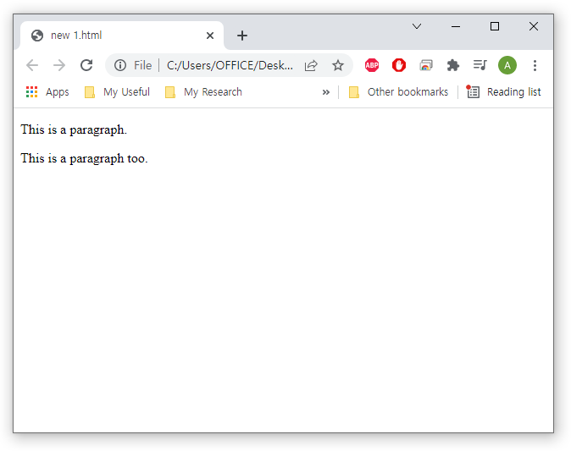
HTML Comments
HTML comments are not displayed in the browser
Syntax
<!-- Write your comments here -->
<!DOCTYPE html>
<html>
<body>
<p>This is a paragraph.</p>
<!-- <p>This is another paragraph </p> -->
<p>This is a paragraph too.</p>
</body>
</html>

Slide 32
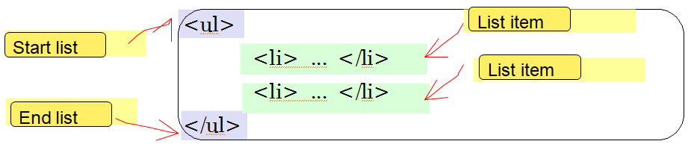
HTML List Elements
Used to list iteams
Unordered list <ul>
Ordered list <ol>

Slide 33
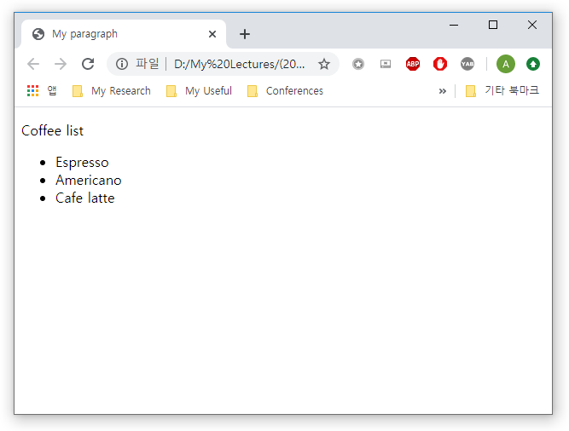
HTML List Elements
Unordered list
An unordered list starts with the <ul> tag
Each list item starts with the <li> tag
<!DOCTYPE html>
<html>
<head>
<title>My paragraph</title>
</head>
<body>
<p>Coffee list</p>
<ul>
<li>Espresso</li>
<li>Americano</li>
<li>Cafe latte</li>
</ul>
</body>
</html>

Slide 34
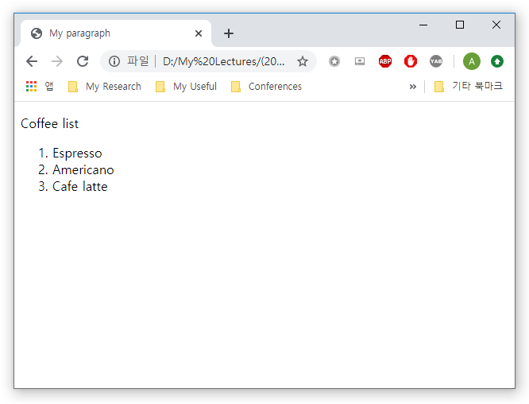
HTML List Elements
Ordered list
An ordered list starts with the <ol> tag
Each list item starts with the <li> tag
<!DOCTYPE html>
<html>
<head>
<title>My paragraph</title>
</head>
<body>
<p>Coffee list</p>
<ol>
<li>Espresso</li>
<li>Americano</li>
<li>Cafe latte</li>
</ol>
</body>
</html>

Slide 35
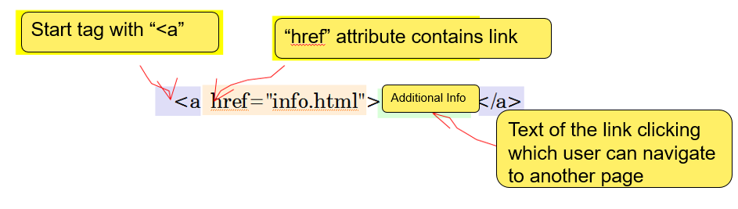
HTML Link Element
<a> tag
A hyperlink (or simply, link) is a word/word phrase/sentence/image that can jump to another document

Slide 36
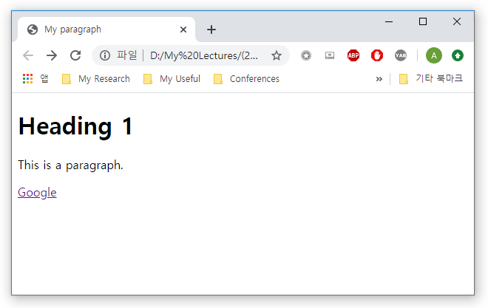
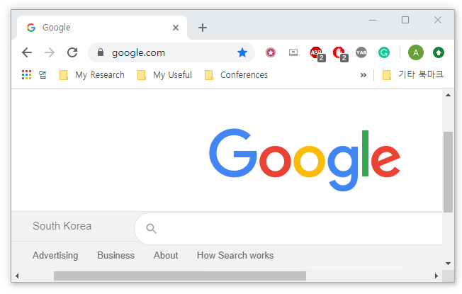
HTML Link Element
<a> tag
Example of hyperlink
<!DOCTYPE html>
<html>
<head>
<title>My paragraph</title>
</head>
<body>
<h1>Heading 1</h1>
<p>This is a paragraph.</p>
<a href="http://www.google.com">Google</a>
</body>
</html>
Click on Google

Slide 37
HTML Link Element
<a> tag
The target attribute specifies where to open the linked document
Attribute Value | Description
_blank | Opens the linked document in a new window or tab
_self | Opens the linked document in the same frame as it was clicked (this is default)
_parent | Opens the linked document in the parent frame
_top | Opens the linked document in the full body of the window

Slide 38
HTML Link Element
<a> tag
Example of target attribute when values are _blank and _self
<!DOCTYPE html>
<html>
<head>
<title>My paragraph</title>
</head>
<body>
<h1>Heading 1</h1>
<p>This is a paragraph.</p>
<a href="http://www.google.com" target="_blank">Google with _blank</a>
<br>
<a href="http://www.google.com" target="_self">Google with _self</a>
</body>
</html>

Slide 39
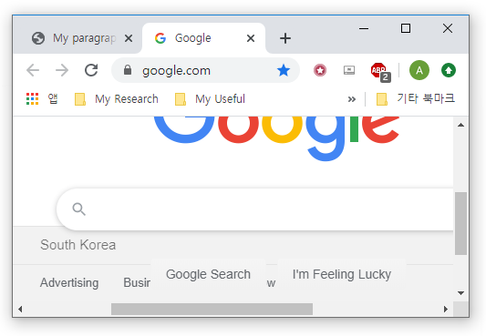
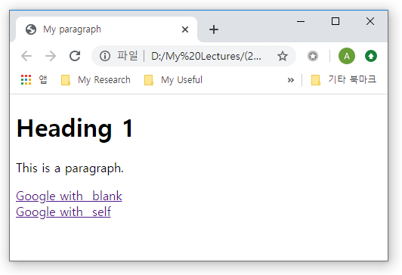
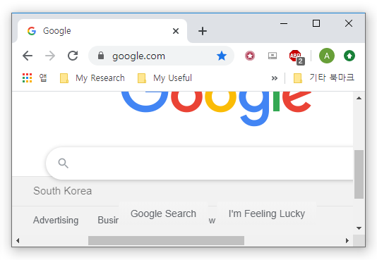
HTML Link Element
<a> tag
Example of target attribute when values are _blank and _self

Slide 40
HTML Link Element
<a> tag
Linking to a specific part of the same page
https://www.upstatelaundromat.com/
<!DOCTYPE html>
<html>
<head>
<title>My paragraph</title>
</head>
<body>
<h1 id="top">Film-Making Terms</h1>
<a href="#arc_shot">Arc Shot</a><br />
<a href="#interlude">Interlude</a><br />
<h2 id="arc_shot">Arc Shot</h2>
<p>A shot in which the subject is photographed by an encircling or moving camera</p>
<h2 id="interlude">Interlude</h2>
<p>A brief, intervening film scene or sequence, notspecifically tied to the plot,
that appears within a film</p>
<p><a href="#top">Top</a></p>
</body>
</html>
Instead of url, we reference “id” attribute with # symbol

Slide 41
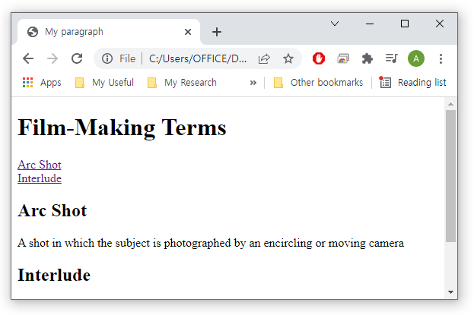
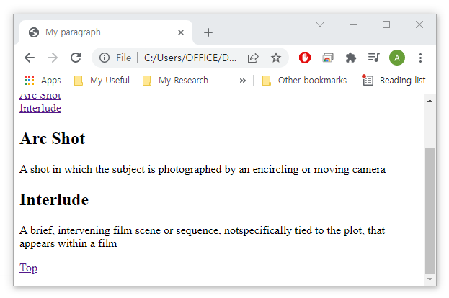
HTML Link Element
<a> tag
Linking to a specific part of the same page

Slide 42
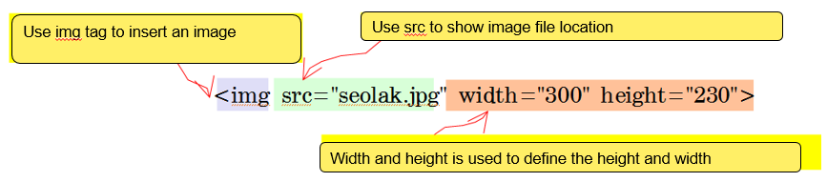
HTML Image Element
<img> tag
It is empty, it contains attributes only, and does not have a closing tag

Slide 43
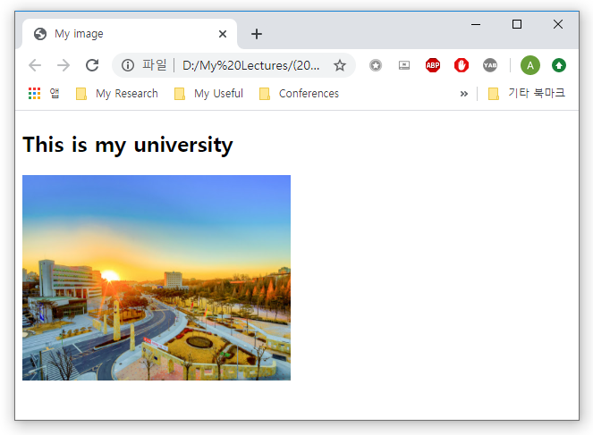
HTML Image Element
<img> tag
Example
Make sure that your image is in the same folder as your HTML file
<!DOCTYPE html>
<html>
<head>
<title>My image</title>
</head>
<body>
<h2>This is my university</h2>
<img src="cbnu.jpg“ width="300"
height="230">
</body>
</html>

Slide 44
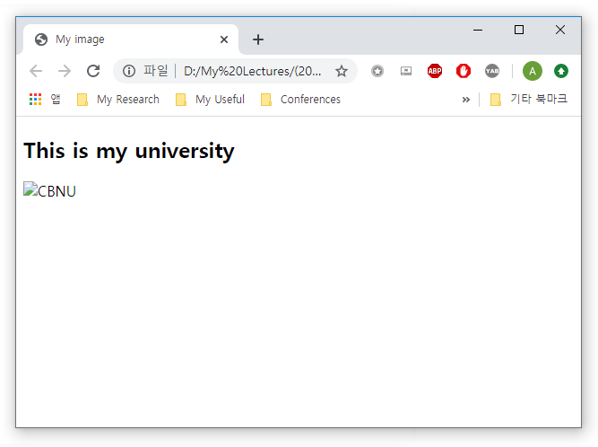
HTML Image Element
<img> tag
The alt attribute provides an alternate text for an image if the image is not found
<!DOCTYPE html>
<html>
<head>
<title>My image</title>
</head>
<body>
<h2>This is my university</h2>
<img src="cbnu.jpg" alt="CBNU"
width="300" height="230">
</body>
</html>

Slide 45
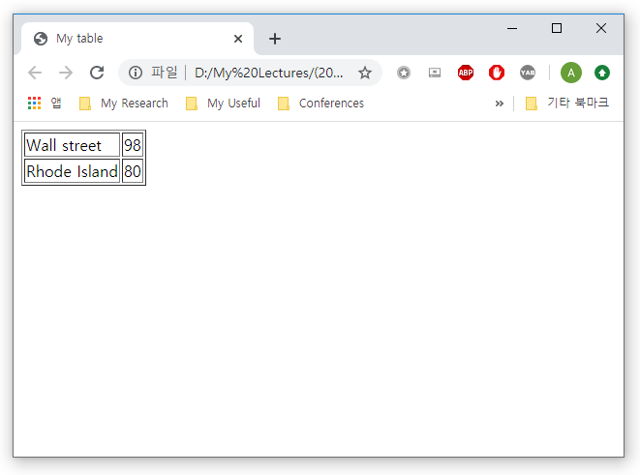
HTML Table Elements
<table> tag
Each table row is defined with the <tr> tag
A table data/cell is defined with the <td> tag
<!DOCTYPE html>
<html>
…
<body>
<table border="1">
<tr>
<td>Wall street</td>
<td>98</td>
</tr>
<tr>
<td>Rhode Island</td>
<td>80</td>
</tr>
</table>
</body>
</html>

Slide 46
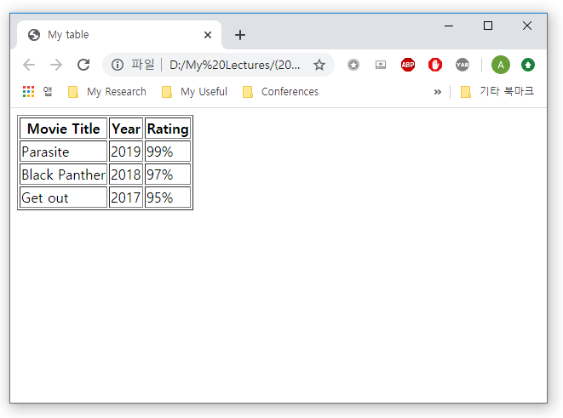
HTML Table Elements
<table> tag
A table header is defined with the <th> tag
<!DOCTYPE html>
<html>
…
<body>
<table border="1">
<tr>
<th>Movie Title</th>
<th>Year</th>
<th>Rating</th>
</tr>
<tr>
<td>Parasite</td>
<td>2019</td>
<td>99%</td>
</tr>
…

Slide 47
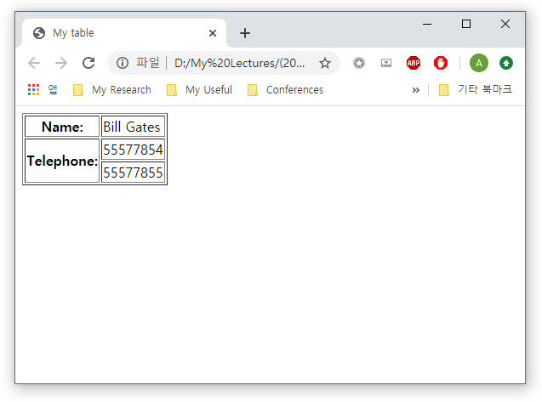
HTML Table Elements
<table> tag
To make a cell span more than one column or one row, use colspan and rowspan attribute
<!DOCTYPE html>
<html>
…
<body>
<table border="1">
<tr>
<th>Name:</th>
<td>Bill Gates</td>
</tr>
<tr>
<th rowspan="2">Telephone:</th>
<td>55577854</td>
</tr>
<tr>
<td>55577855</td>
</tr>
…

Slide 48
Summary
HTML heading elements
<h1> to <h6>
HTML text elements
<p>, <br>, <hr> and text formatting elements
HTML list elements
<ol> and <ul>
HTML link element
<a> and its attributes: href and target
HTML image
<image> and its attributes: width, height, alt
HTML table
<table>, <tr>, <td>, <th> and attributes: rowspan and colspan

Slide 49
Create your personal website
Part 3

Slide 50
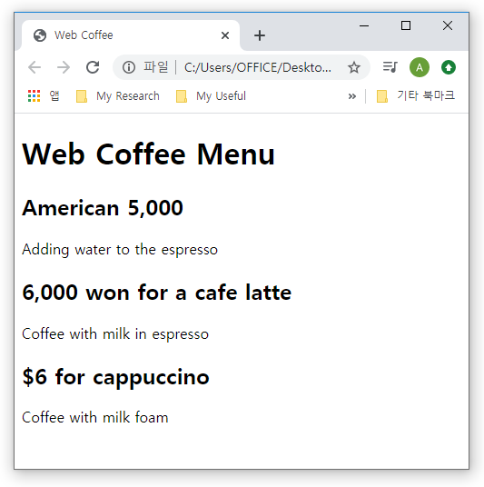
Practice - HTML Text Elements
Practice 1
<h1>, <h2> and <p> elements
<!DOCTYPE html>
<html>
<head>
<title>Web Coffee</title>
</head>
<body>
<h1>Web Coffee Menu</h1>
<h2>American 5,000</h2>
<p>Adding water to the espresso</p>
<h2>6,000 won for a cafe latte</h2>
<p>Coffee with milk in espresso</p>
<h2>$6 for cappuccino</h2>
<p>Coffee with milk foam</p>
</body>
</html>

Slide 51
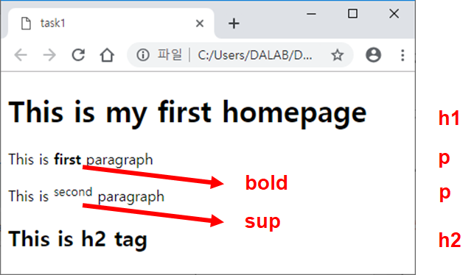
Practice - HTML Text Elements
Task 1
Create the following HTML page with <h1>, <h2>, <p> text elements, and <bold> and <sup> text formatting elements

Slide 52
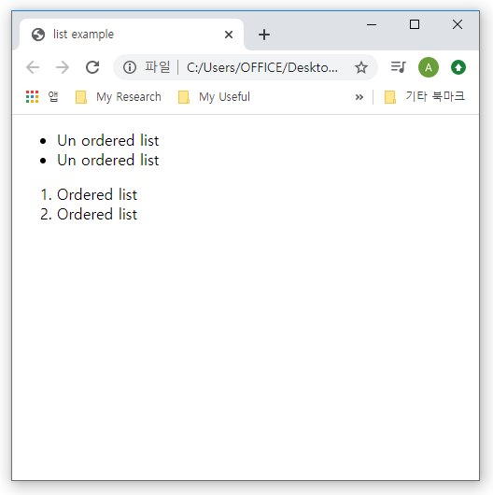
Practice - HTML List Elements
Practice 2
<ul>, <ol> and <li> elements
<!DOCTYPE html>
<html>
<head>
<title>list example</title>
</head>
<body>
<ul>
<li>Un ordered list</li>
<li>Un ordered list</li>
</ul>
<ol>
<li>Ordered list</li>
<li>Ordered list</li>
</ol>
</body>
</html>

Slide 53
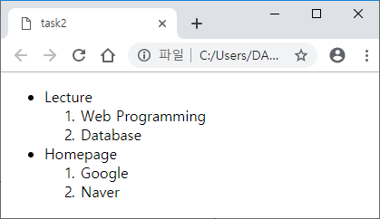
Practice - HTML List Elements
Task 2
Create an ordered list inside of unordered list as follows:
List in another List

Slide 54
Practice - HTML Link Elements
Practice 3
<a> tag, 'href' attribute and 'target' attribute with _blank and _self
<!DOCTYPE html>
<html>
<head>
<title>My paragraph</title>
</head>
<body>
<h1>Heading 1</h1>
<p>This is a paragraph.</p>
<a href="http://www.google.com" target="_blank">Google with _blank</a>
<br>
<a href="http://www.google.com" target="_self">Google with _self</a>
</body>
</html>

Slide 55
Practice - HTML Link Elements
Practice 3
<a> tag, 'href' attribute and 'target' attribute with _blank and _self

Slide 56
Practice - HTML Image Element
Practice 4
<img> tag and ‘width’, ‘height‘ and ‘alt‘ attributes
<!DOCTYPE html>
<html>
<head>
<title>Web Programming</title>
</head>
<body>
<h1> Welcome to Web Coffee! </h1>
<img src = "coffee.jpg" width="400" height="300" alt="coffee_image">
<br>
<img src = "cup.jpg" width="400" height="300" alt="cup_image">
<p>If you want to taste fresh coffee in house roasting beans
<em> Certified Level 1 Barista </em> uses only the finest beans,
which carefully selected.</p>
<h2> Menu </h2>
<p>Americano, cafe latte, cappuccino, cafe mocha, ...</p>
</body>
</html>

Slide 57
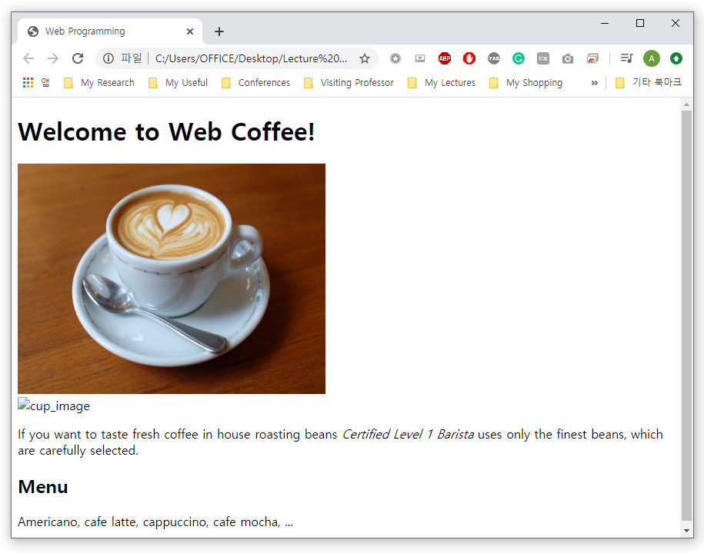
Practice - HTML Image Element
Practice 4
<img> tag and ‘width’, ‘height‘ and ‘alt‘ attributes

Slide 58
Practice - HTML Image Element
Practice 5 – Hyperlink using an image
<!DOCTYPE html>
<html>
<head>
<title>Images from NASA</title>
</head>
<body>
<h1> Images from NASA </h1>
<p>NASA in the United States provides high resolution images of the universe.</p>
<h2> Hubble Images </h2>
<p>It is an image taken by the Hubble telescope and shows the early galaxy of the universe.</p>
<a href=“5. photo1.html">
<img src="hubble1.jpg" alt="" width="200" height="200">
</a>
<a href=“5. photo2.html">
<img src="hubble2.jpg" alt="" width="200" height="200">
</a>
</body>
</html>
5. image_link.html
‘5.photo 1.html’ and ‘5.photo 2.html’ must be in the same folder with ‘5. image_link.html'

Slide 59
Practice - HTML Image Element
Practice 5 - Hyperlink using an image
<!doctype html>
<html>
<head>
<title>Deep Field</title>
</head>
<body>
<h1>Hubble Image #1</h1>
<p><img src="hubble1.jpg" alt="Deep Field" width="500" height="500"></p>
</body>
</html>
5. photo1.html
<!DOCTYPE html>
<html>
<head>
<title>Deep Field</title>
</head>
<body>
<h1>Hubble Image #2</h1>
<p><img src="hubble2.jpg" alt="Deep Field" width="500" height="500"></p>
</body>
</html>
5. photo2.html

Slide 60
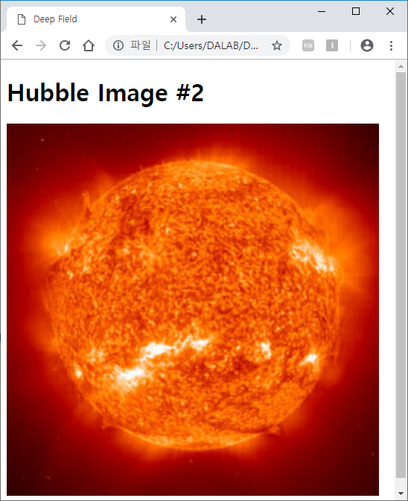
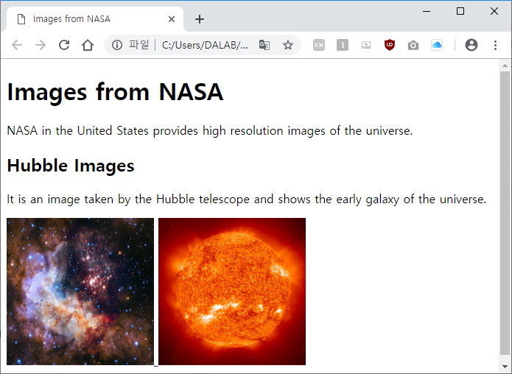
Practice - HTML Image Element
Practice 5 - Hyperlink using an image
Click on image

Slide 61
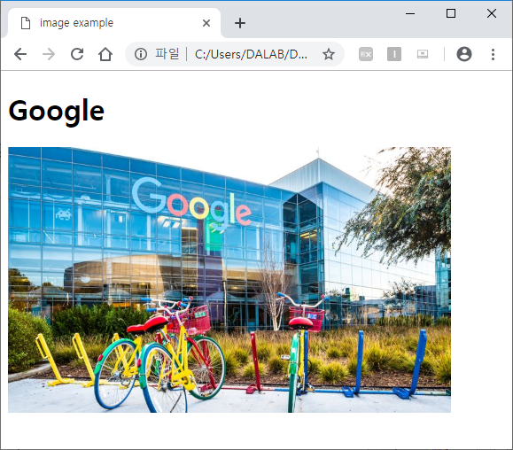
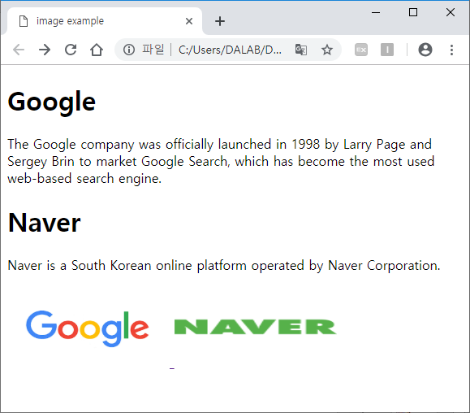
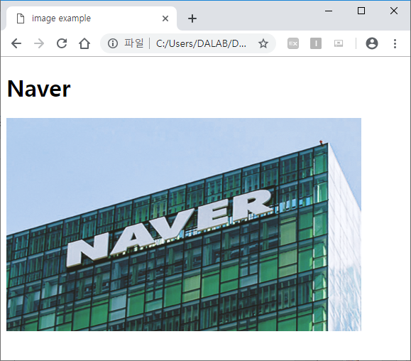
Practice - HTML Image Element
Task 3
When you click on Google or Naver image, it should open on a new page with target=“_blank”

Slide 62
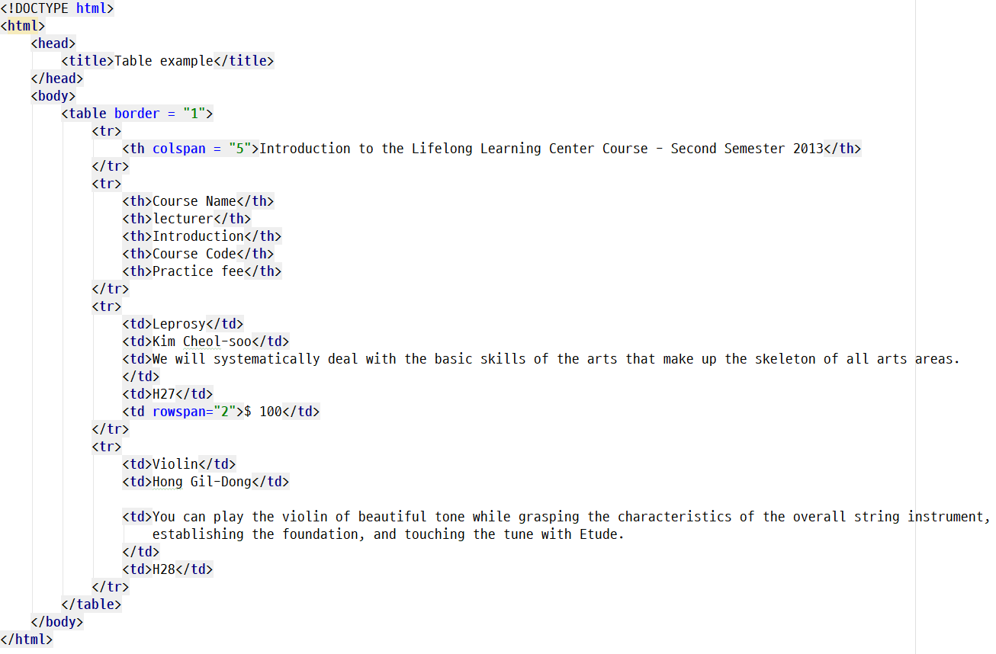
Practice - HTML Table Element
Practice 6
<table>, <tr>, <td>, <th> and colspan and rowspan attributes
Combine five columns
Combine two rows

Slide 63
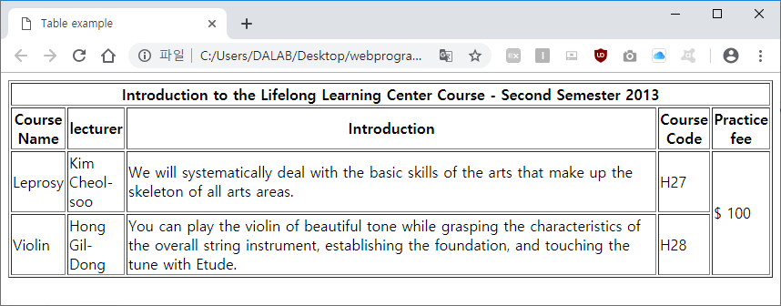
Practice - HTML Table Element
Practice 6
<table>, <tr>, <td>, <th> and colspan and rowspan attributes

Slide 64
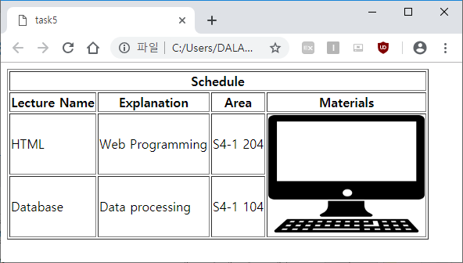
Practice - HTML Table Element
Task 4
Create the following table using <table>, <tr>, <td>, <th> and colspan and rowspan attributes + <img> tag

Slide 65

Practice – Your first website
Final Practice

Slide 66
Practice – Your first website
Final Practice

Slide 67
Homework for Lecture 3
Create your own personal website using the tags studied during Lecture 3
HTML heading elements
<h1> to <h6>
HTML text elements
<p>, <br>, <hr> and text formatting elements
HTML list elements
<ol> or <ul>
HTML link element
<a> and its attributes: href and target
id attribute to link to the same page
HTML image
<image> and its attributes: width, height, alt
HTML table
<table>, <tr>, <td>, <th> and attributes: rowspan and colspan
Deadline: March 18, 2022 12:59

Slide 68
See you next time!
Questions?

